Slide 1

Exploring Energy Burdens at the County Level
Dina Stretiner
Data to Policy Symposium

Slide 2


What is energy burden? Why is it important?
Energy burden is a proportion of income that a household spends on energy: electricity, heating and cooling
Energy insecurity manifests itself by households forgoing food or other necessities to pay for energy costs
Energy burden varies by county and state, it is a pressing issue for vulnerable populations.
Statistical model will examine the relationship between high energy burdens and county demographics.
Image credit: Dollar Energy Fund

Slide 3

Logistic Regression Model
Logistic regression model is used to predict a binary outcome: yes/no.
In our case, the outcome is whether the county’s average energy burden is greater than 4%. (>=4%: yes, < 4%: no)
Model includes only statistically significant variables: State, Population (log transform), Unemployment Rate, Rural-Urban Designation, Minority Indicator, Low Income Indicator, Less than High School Indicator.
Data credit: National Renewable Energy Lab

Slide 4
Model Results
Logistic regression model assumptions have been verified to a reasonable degree.
Key Take-Aways:
The odds of a county having average energy burden over 4% is 81% lower for a county in Colorado, compared to one in Alabama (baseline). These odds are an estimate, we are 95% sure that the true odds fall between 49% lower and 93% lower.
Compared to a county with a metro population of 1 million or more (baseline, urban flag = 1), a county with a metro population of less than 250K residents has 40% higher odds of having average energy burden over 4%. 95% confidence interval spans 17% lower odds and 136% higher odds.
When low income indicator goes up by 1, the odds of the county having energy burden over 4% go up by a factor of 8. 95% confidence interval spans factor of 4 to factor of 15.
Note: model yielded a negative relationship between odds of high energy burden and minority indicator. This is not supported by literature, because areas with high minority population generally have higher energy burdens.

Slide 5
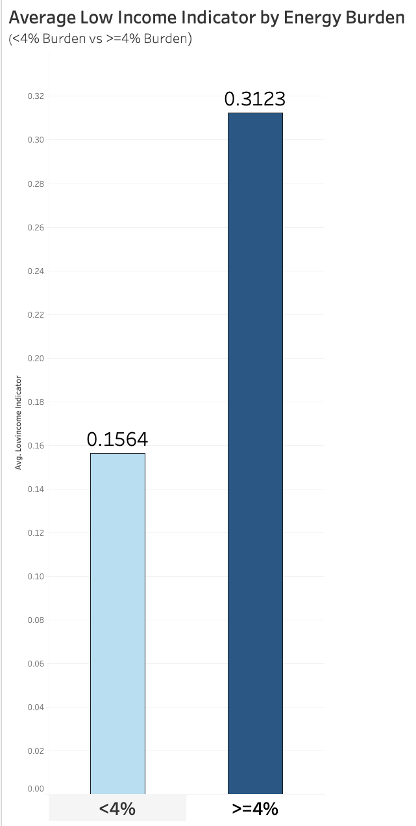
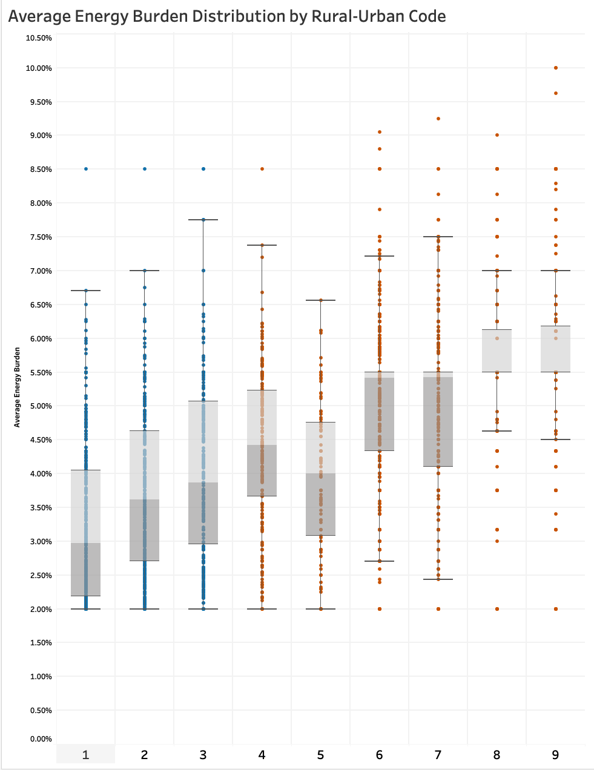
Energy Burden vs Low Income Indicator & Rural-Urban Code
Graph on the left: counties with a high energy burden (>=4%) generally have a higher proportion of low income residents
Graph on the right: blue box plots indicate metro counties, orange – non-metro counties. The general trend is that metro counties have lower energy burden.
*Note: Average energy burden shown is a weighted average estimate.

Slide 6
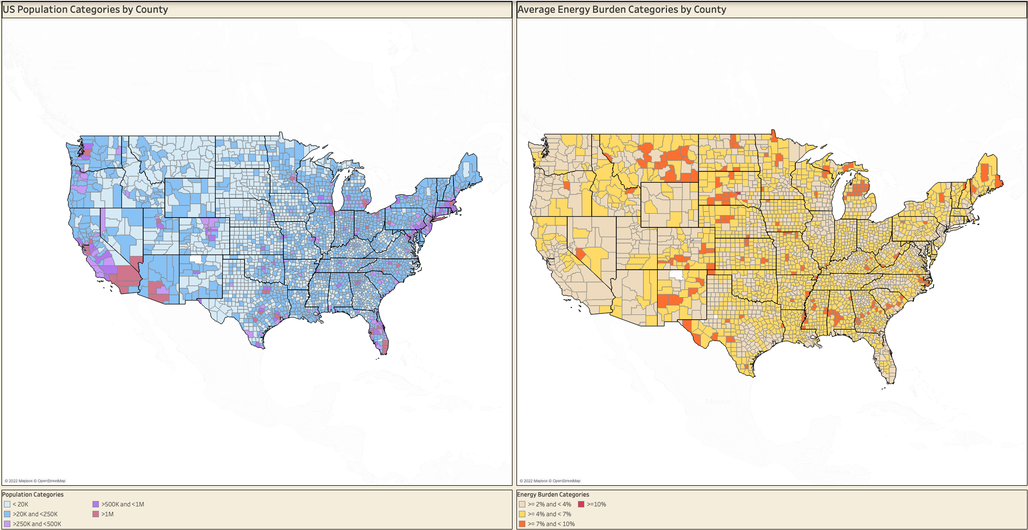
Energy Burden and Population Map
*Note: Average energy burden shown is a weighted average estimate.

Slide 7
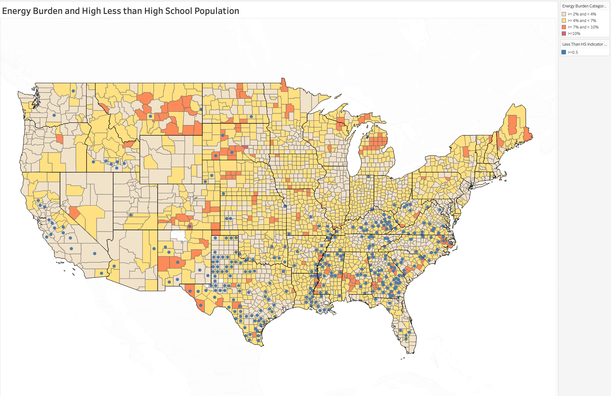
Energy Burden and Education Map
Beige through red colors repressed progressively higher county energy burden. Blue dots represent counties with a high population of individuals without high school diploma.

Slide 8
Policy and Recommendations Decrease Energy Burden by Increasing Equipment Efficiency
Energy consumption higher for cooling than heating
Low income households in South Eastern US use 36% more electricity than those nationwide, despite having lower average cost per kWh (US Department of Energy, 2018).
Central A/C may be more energy efficient than window units. Avg cost $5,600
Heat pumps - great energy efficiency solution for cooler climates. Avg cost $5,500 (Glavinskas, 2022)
Rebates from Inflation Reduction Act.
Cost after rebates ~$4,000
Not accessible to renters
Solution: provide energy efficiency rebates to landlords
Solution: modify the Landlord-Tenant Act to incorporate energy efficiency equipment requirements.

Slide 9
Policy and Recommendations Decrease Energy Burden by Streamlining Bill Subsidy
Low Income Home Energy Assistance (LIHEAP) – Federal Program to help with energy bills
To qualify in CO, gross household income must be 60% of State Median Income (Colorado Department of Human Services, 2022)
Program exists outside of other social safety net programs – consider combining
If person qualifies for a housing voucher, check eligibility for LIHEAP.

Slide 10
Policy and Recommendations Decrease Energy Burden for Rural Areas
Rural areas pay more for electricity because of less population density
In some regions, more than 20% of households live in manufactured housing. 70% of manufactured housing is located in rural areas.
Manufactured housing is not energy efficient: leakage and poor insulation (Ross et all, 2018)
Educate residents about the DOE Weatherization Assistant Program.
Department of Energy needs to consider conducting energy audits of manufactured housing and reporting back to manufacturers
Rural areas rely on distribution co-ops for electricity. Co-ops purchase wholesale from G&Ts: Generation and Transmission associations (Ross et all, 2018)
Long-term contracts between co-ops and G&Ts may leave co-ops at a disadvantage
Federal Energy Regulatory Commission (FERC) governs the relationship, but lots of red tape (Powering Cooperatives, 2019).
States need to advocate to FERC on behalf of rural co-ops.

Slide 11
Summary
Model. Logistic regression model predicts odds of average county energy burden being >=4%
Model. Predictors: State, Population (log transform), Unemployment Rate, Rural-Urban Designation, Minority Indicator, Low Income Indicator, Less than High School Indicator.
Recommendations. Decrease Energy Burden by Increasing Equipment Efficiency
Recommendations. Decrease Energy Burden by Streamlining Bill Subsidy
Recommendations. Decrease Energy Burden for Rural Areas

Slide 12
Sources
Day, Megan; Ross, Liz (2021): Equitable Energy Investment Prioritization Data Set. National Renewable Energy Laboratory. https://data.nrel.gov/submissions/175
US Department of Energy, Office of Energy Efficiency & Renewable Energy (2018). Low-Income Household Energy Burden Varies Among States – Efficiency Can Help in All of Them. https://www.energy.gov/sites/prod/files/2019/01/f58/WIP-Energy-Burden_final.pdf
Glavinskas, Vanessa (2022). Environment Defense Fund. 8 ways the Inflation Reduction Act can save you money. https://www.edf.org/article/8-ways-inflation-reduction-act-can-save-you-money
Colorado Department of Human Services (2022). Low Income Energy Assistance Program. https://cdhs.colorado.gov/leap
Ross, Lauren; Drehobl, Ariel; Stickles, Brian (2018). American Council for Energy Efficient Economy. The High Cost of Energy in Rural America. https://www.aceee.org/sites/default/files/publications/researchreports/u1806.pdf
Powering Cooperatives, A Policy Primer (2019). CSU Center for the New Energy Economy. https://cnee.colostate.edu/wp-content/uploads/2019/03/Powering-Cooperatives-CNEE-Report-on-Colorado-Cooperatives-and-TriState.pdf

